Slide 1
Lecture 12: Single Sample Hypothesis Testing
Jibo He, Ph.D.
Associate Professor
Wichita State University
jibo.he@Wichita.edu

Slide 2
Knowledge check
Null and Alternative hypothesis
Directional vs. Non-directional hypothesis (one tail vs. two-tail tests)
Extreme score
It is a score that has a low probability of occurrence.
How low is low?
Level of significance, say, .05, which means if the probability of occurrence is lower than .05, we regard it as extreme.

Slide 3
Knowledge check
Critical value and critical region (a.k.a. region of rejection)
The critical value is the beginning of the critical region. If our calculated test statistic meets or exceeds the critical value, thereby falling into the critical region, we reject the null hypothesis.
Both are determined by the level of significance.

Slide 4
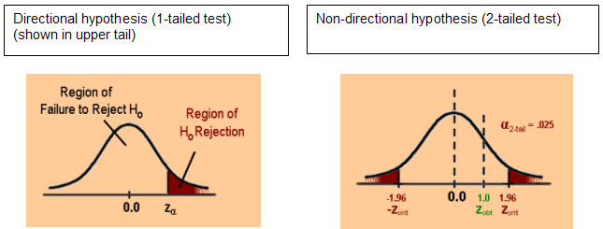
Graphic representation of the region of rejection and region of non-rejection
Notes:
The critical value is the beginning of the critical region. If our calculated test statistic meets or exceeds the critical value, thereby falling into the critical region, we are in a position to reject the null hypothesis.

Slide 5
Steps in Testing Hypotheses
Step 1. Based on the research question, specify the appropriate null & alternative hypotheses (H_{A} and H₀)
Strategy: Model the researcher’s belief in H_{A}, set up H₀ as its logical opposite
Step 2. Specify the test to perform(e.g., one-sample z-test, t-test, independent t-test, dependent t-test, chi-square), the level of significance (usually 0.05), and the directionality of the test

Slide 6
Step 3. Sketch the sampling distribution of the test statistic with the region of rejection shaded and the critical value(s) (found from a proper table) clearly indicated
Step 4. Compute the test statistic using the sample data
Step 5. Locate the observed test statistic on the sampling distribution and state the decision regarding H₀ – reject H₀ or retain H₀
Step 6. Interpret the results (draw an inference) to answer the researcher’s question (very important – do not forget this step!)

Slide 7
One sample Z-test

Slide 8
One Sample Z Test
Purpose:
Use a sample mean to test a hypothesis about a population mean in order to determine if the sample drawn belongs to the specified population (or if it belongs to a different population)

Slide 9
Example for One Sample Z Test
A new math program is designed to improve math SAT scores. Thus, administrators believe students in the new program will score higher on the math SAT than other students taking the test. The national mean for math SAT is 500 with a standard deviation of 100. If we draw a sample of 36 students from the new math program and find their math SAT mean is 518, do we have evidence the new program is effective? Evaluate at the 5% level of significance.

Slide 10
Sampling Distribution
The statistic corresponding to μ is:
There are three general properties which define the sampling distribution of
The distribution of is normally distributed
The mean of the sampling distribution is
The standard deviation of the sampling distribution (also called the standard error of the mean) is:

Slide 11
Assumptions
1. Independence of observations (through random sampling)
2. Scores in the population are normally distributed
The Central Limit Theorem allows us to overlook assumption 2.
Recall that the Central Limit Theorem states that as the sample size increases (normally, n is greater than 30), the sampling distribution will approach a normal distribution.
3. population standard deviation ( ) is known

Slide 12
The Z Statistic
Z will follow a standard normal distribution, from which we can figure out the critical value and rejection region.

Slide 13
Critical Values
Some frequently used values from our standard normal distribution table:
Follow the 6-step procedure to test the hypothesis
Z | Area beyond the Z
1.645 | .05
1.96 | .025
2.33 | .01
2.58 | .005

Slide 14
Step 1.
Based on the Research Hypotheses, specify the appropriate statistical hypotheses (H_{A} and H₀)
H₀: μ ≤ 500 and H_{A}: μ > 500
Step 2.
Specify the test to perform, the level of significance, sample size and the directionality of the test
One sample z test;
α = .05
n = 36
One tailed test with region of rejection in the upper tail of the sampling distribution

Slide 15
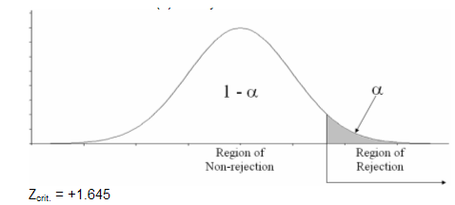
Step 3.
Sketch the sampling distribution of the test statistic with the region of rejection shaded and the critical value(s) clearly indicated

Slide 16
Step 4.
Compute the test statistic using the sample
Step 5.
Locate the observed test statistic on the sampling distribution and make decision
Since the Z_{obs}. is smaller than Z_{crit}, we fail to reject (retain) H₀

Slide 17
Step 6.
Interpret the results to answer the researcher’s question
“Our results do not suggest that the new math program improves math SAT scores”

Slide 18
Example for One Sample Z Test
What would our decision be if we found the sample mean of 518 based on 100 students?

Slide 19
Example for One Sample Z Test
What would our decision be if we found the sample mean of 518 based on 100 students?
In this case, everything remains the same for step 1 – step 3
Step 4.
Compute the test statistic using the sample data

Slide 20
Step 5.
Since the Z_{obs}. is greater than Z_{crit}, we reject H₀
Step 6.
Interpret the results to answer the researcher’s question
“Our results suggest that the new math program does improve math SAT scores.”

Slide 21
One sample T-test

Slide 22
One Sample T-Test
Purpose:
Use a sample mean to test a hypothesis about a population mean in order to determine if the sample drawn belongs to the specified population (or if it belongs to a different population)
Distinction: σ is unknown (more realistic because σ is usually never known)
Solution: estimate σ with S_{X}

Slide 23
Assumptions
1. Independence of observations (through random sampling)
2. scores in the population are normally distributed
The t-Statistic:
Where is the estimated standard error of the mean, used to estimate

Slide 24
Characteristics of Student t Distribution
t distribution is a family of distributions, where each distribution is characterized by its degrees of freedom (df).
The mean of the t distribution = 0.
t distribution is symmetric about its mean.
t distribution is unimodal.

Slide 25
Characteristics of Student t Distribution
t distribution has lower peak and fatter tail than the normal distribution (implies larger or more extreme critical value for t as compared to Z)
t distribution is a family of distributions, each distribution is characterized by its degrees of freedom (df).
As the sample size increases, t distribution approaches the standard normal distribution. When n , t distribution → Z distribution.

Slide 26
Degrees of Freedom (df)
df corresponds to the # of observations that are completely free to vary
df = n – 1

Slide 27
Finding Critical Values Under the t Distribution (tcrit.)
To use the table, we need to know
df
Level of significance
One-tail or two-tail test
(if the proper df is not listed in the table, choose the next LOWEST df in the table to get t_{crit}.)

Slide 28
Exercise for finding critical values for use in the 1-sample t-test:
for n = 45, df = 44, α = .05, 1 tailed test:
for n = 20, df = 19, α = .05, 2 tailed test:

Slide 29
Example
The national mean for the English component of the ACT test is 18.9. You wish to know whether performance of students at a certain high school differs from the national mean on the test. You randomly select 25 students and obtain the following results: = 16.1, S_{X} = 5.2
Assume the data follow a normal distribution, evaluate these results at the 5% level of significance.

Slide 30
Step 1.
Based on the Research Hypotheses, specify the appropriate statistical hypotheses (H_{A} and H₀).
H₀: μ = 18.9 and H_{A}: μ ≠ 18.9

Slide 31
Step 2.
Specify the test to perform, the level of significance, sample size (degrees of freedom, if needed) and the directionality of the test
One sample t test;
α = .05
n = 25
df = n – 1 = 24
Two-tailed test with region of rejection in both tails of the sampling distribution. The area under the curve in each region of rejection will be α/2 = .025

Slide 32
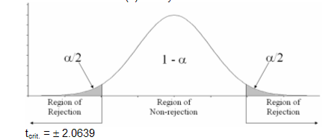
Step 3.
Sketch the sampling distribution of the test statistic with the region of rejection shaded and the critical value(s) clearly indicated

Slide 33
Step 4.
Compute the test statistic using the sample data
Step 5.
Our observed t-statistic is more extreme than the critical t-value, so we reject Ho

Slide 34
Step 6.
Interpret the results to answer the researcher’s question
“Our results suggest that the performance of students at that high school is lower than the national mean on the English component of the ACT test”

Slide 35
Exercise!
A researcher is interested in the relationship between anxiety and memory, so she takes 20 people diagnosed as having high anxiety, and gives them a memory probe. The probe is designed to have a mean of 8 items correct in the general population, but little else is known about its properties.
The mean of scores (for the anxious people) on the memory probe is 7.1, while the standard deviation of scores (for the anxious people) on the memory probe is s=1.62. Do highly anxious people perform significantly worse than the general population?

Slide 36
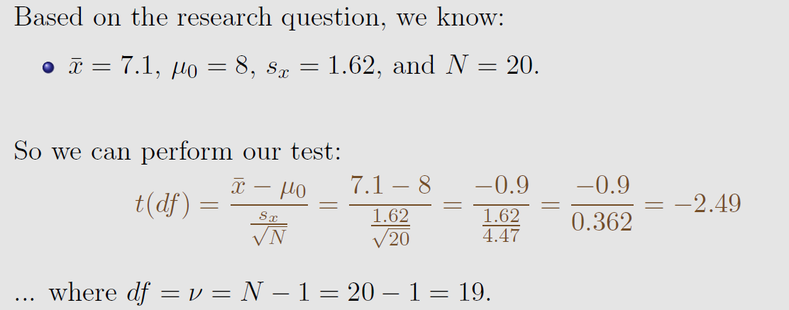

Answers
H0 : $µ_{\text{anxiety}}$ 8
H1 : $µ_{\text{anxiety}}$ < 8
We need to refer to a t-distribution with df=19
Assume a one-tailed test with α=.05

Slide 37
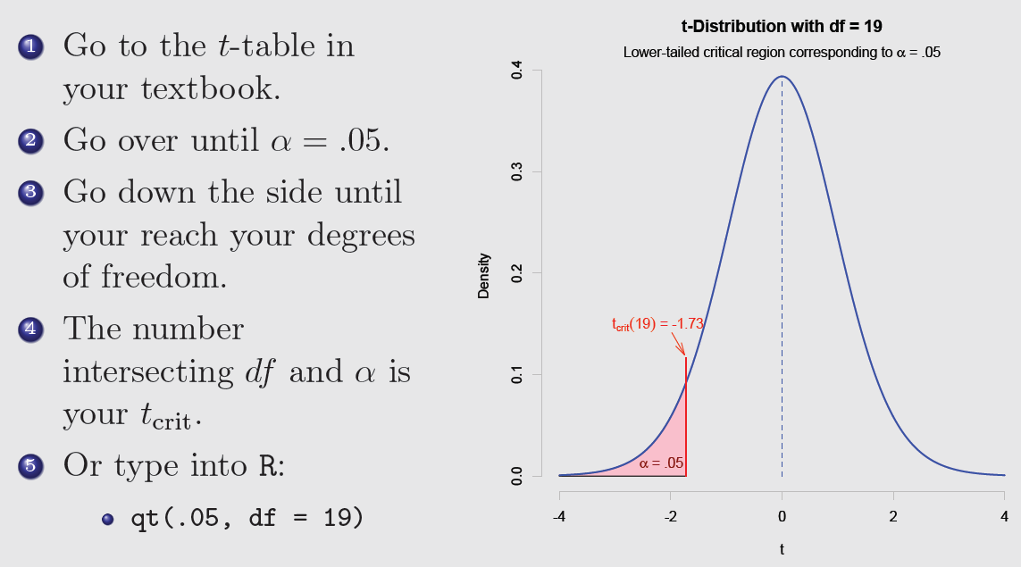
Make a decision: find critical value

Slide 38
Quiz 6 Preparation
Quiz 6 will focus on one-sample t-test
You need to know how to compute observed t-value, and how to find a critical value from a t-table.

Slide 39
A researcher wants to know if the sentencing practices for first-time drug offenders in his county are different than sentencing practices in the state as a whole. A recent news report indicates that the mean number of years to which first-time drug offenders in the state are sentenced is 12.16. A sample of 25 court records from the researcher’s county indicates a mean number of years = 11.24, with a standard deviation of 3.11. Test the null hypothesis at the .05 level of significance.
For this scenario,
H₀: The sample was selected from a population with µ = 12.16.
H₁: The sample was selected from a population with µ ≠ 12.16.
(1 point) What is/are the critical value(s) of t?
(3 points) Compute the observed value of t.
(1 point) Compare the observed value to the critical value(s) and state your decision regarding the null hypothesis.

